Slide 1

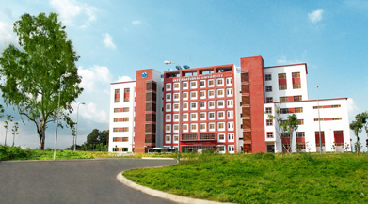
International University
MICRO-PROCESSING SYSTEM
Lecture 0B:
INTRODUCTION Microprocessors
Vo Minh Thanh, M.Eng
School Of Electrical Engineering

Slide 2
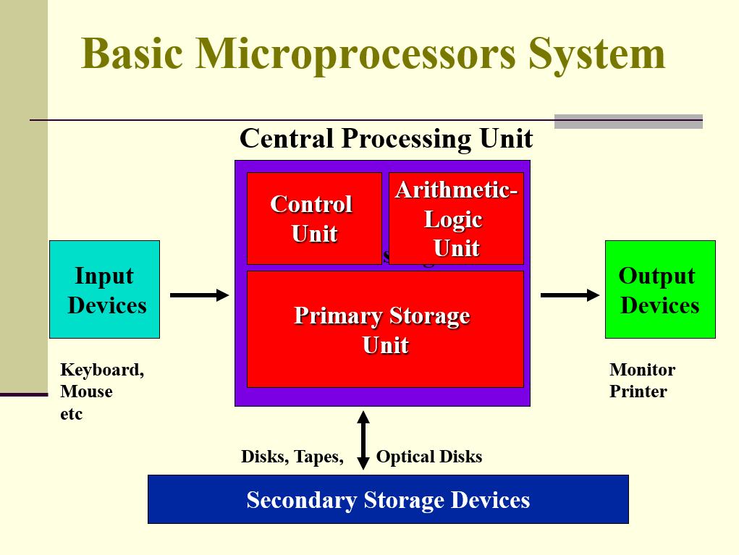
INTEL CORE I7
29
Slide <number>

Slide 3
Microprocessor
• Microprocessor: is a single integrated circuit (IC) that accepts and executes coded instructions (machine code or machine language) for the
purpose of manipulating data and controlling the associated circuitry (RAM, ROM, and I/O ICs) in a digital system.. In the world of personal computers, the terms microprocessor and CPU are used interchangeably.
• A microprocessor (sometimes abbreviated µP) is a digital electronic component with miniaturized transistors on a single semiconductor integrated circuit (IC).
• One or more microprocessors typically serve as a central processing unit (CPU) in a computer system or handheld device.
• Microprocessors made possible the advent of the microcomputer.

Slide 4
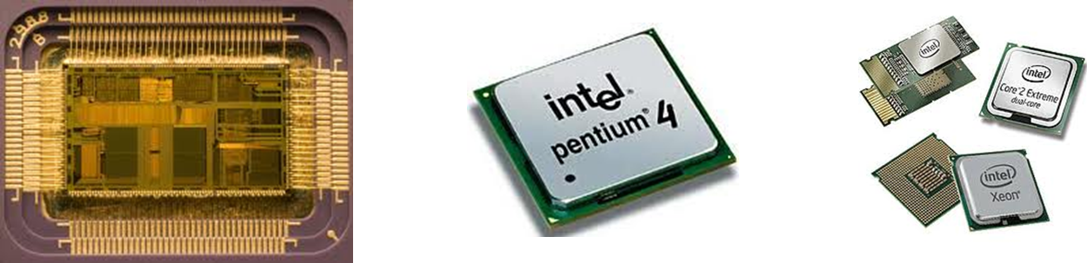
Microprocessor
→At the heart of all personal computers and most working stations sits a microprocessor.
→Microprocessors also control the logic of almost all digital devices, from clock radios to fuel-injection systems for automobiles.
→Three basic characteristics differentiate microprocessors:
Instruction set: The set of instructions that the microprocessor can execute.
Bus width : The number of bits processed in a single instruction.
Clock speed : Given in megahertz (MHz), the clock speed determines how many instructions per second the processor can execute.

Slide 5
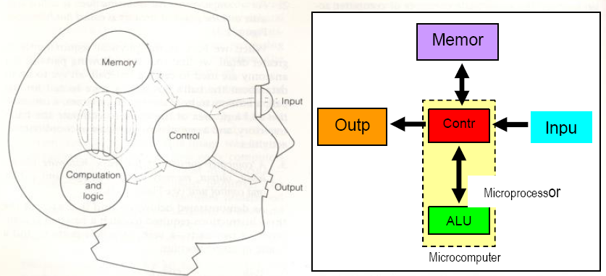
Microcomputer
→A Microcomputer is an integrated system of computer components typically containing data storage ICs, mass storage elements, and standard I/O devices, capable of a wide variety of applications. Microcomputers contain a microprocessor at the heart of the system, controlling data flow, manipulating data, and executing instructions.
→The term microcomputer is generally synonymous with personal computer, or a computer that depends on a microprocessor.
→Microcomputers are designed to be used by individuals, whether in the form of PCs, workstations or notebook computers.

Slide 6
Microcomputer
A microcomputer system consists of the following components:
Peripheral Input
Peripheral Output
Peripheral Storage
Central Processing Unit
→Peripheral Input: It is a tool to be used to prepare data or information which will be processed by Central Processing Unit. Example: Joystick, Keyboard, Sensor, Scanner
→Peripheral Output: It is a tool to be used to display data or information which has been processed by Central Processing Unit. Example: Monitor, Printer, Speaker
→Peripheral Memory: It is a tool to be used to store data or information which will be processed or has been processed by Central Processing Unit. Example: Hard disk, CD-ROM, RAM, ROM, Pen drive
→Central Processing Unit (CPU): It is the most important part in microcomputer system. It acts as a “brain” of a microcomputer system. It is also called Microprocessor.

Slide 7
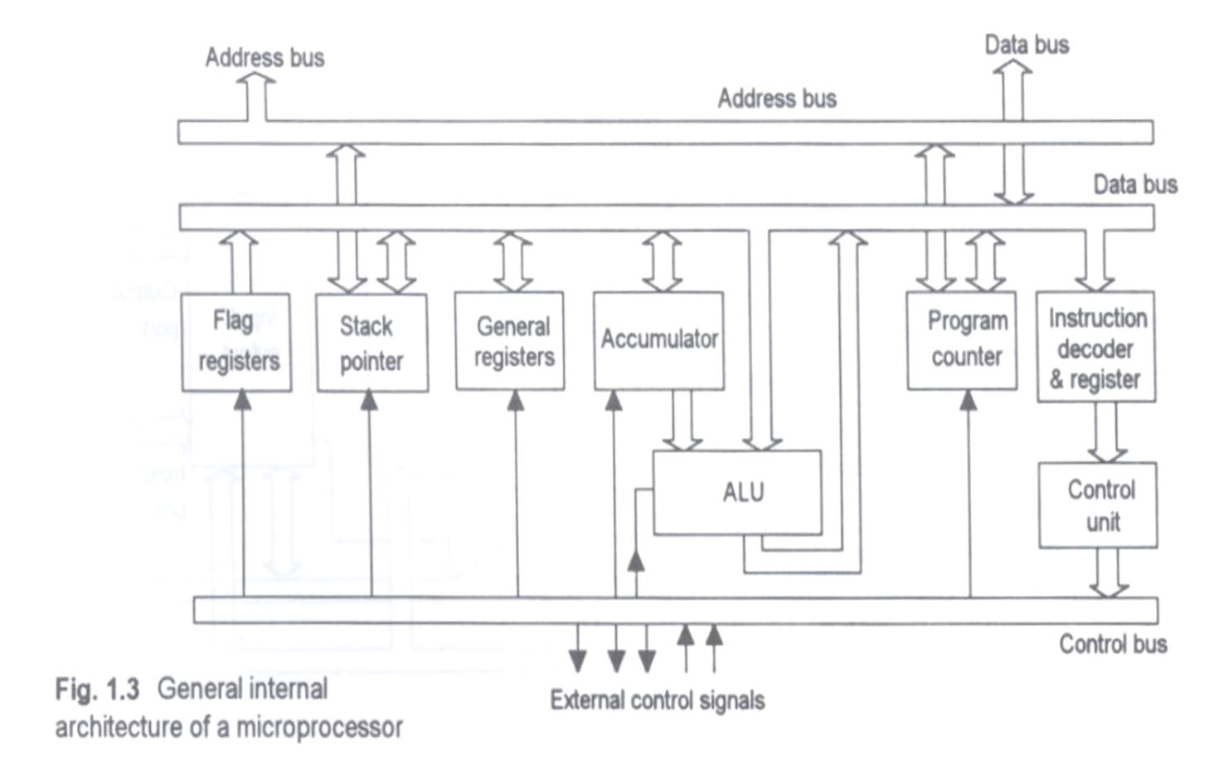
Internal Components of Microprocessors

Slide 8
Internal Components of Microprocessors
ALU (Arithmetic Logic Unit)
It performs arithmetic task such as addition, deduction, multiplication and
division and logic task such as AND, OR, NOT and etc.
ACC (Accumulator)
It is a register which can store data for temporary before sending to process in
ALU and also can store the processed data before sending to store in the memory or display through peripheral output.
It is just like a “entrance” for a data to go in and come out from ALU.
Flag register/PSW (Program Status Word ) register
This register contains information regarding the result of a process which has
been carried out by ALU.
It tells the user whether the result has Carry (CY), Auxiliary Carry (AC), Odd or
Even Parity (P) or Overflow (OV) or the other way round.
It also consists information regarding registers from which bank will be working
on.

Slide 9
Internal Components of Microprocessors
Program Counter (PC)
It controls the sequence in which the instructions in a program are performed.
Normally, it does this by counting in the sequence, that is 0, 1, 2, 3, …
At any given time, the count indicates the location in memory from which the
next location of information/instruction is to be taken.
v. Stack Pointer (SP)
This register will store the contains of Program Counter (location of memory)
for a short time when there is subroutine/sub-program occurs in the program.
This register will be taken place when some particular instructions, such as
PUSH, POP, CALL and RET are used in the program.
vi. Data Register
This register is a temporary storage location for data going to or coming from
the data bus.
vii. Address Register
This register is another temporary storage location.
It holds the address of the memory location or I/O device that is used in the
operation presently being performed.

Slide 10
Internal Components of Microprocessors
Instruction Decoder
After an data is pulled from memory and placed in the data register, the data is
decoded by this circuit.
The decoder checks the code and decides which operation is to be performed.
Controller-sequencer
This unit will produce a variety of control signals to carry out the instruction.
Since each instruction is different, a different combination of control signals is
produced for each instruction.
Data Bus
It is a group of wires that is used to channel data (which to be processed or
after processed) from peripherals (memory or I/O devices) to CPU or vice versa.
Address Bus
It is a group of wires that is used to channel locations of data which will be or
has been processed.
Control Bus
It is a group of wires that is used to send control signals (such as MEMW,
MEMR, IOR, IOW, interrupt and DMA) from CPU to peripheral (memory or I/O
devices) or vice versa.

Slide 11
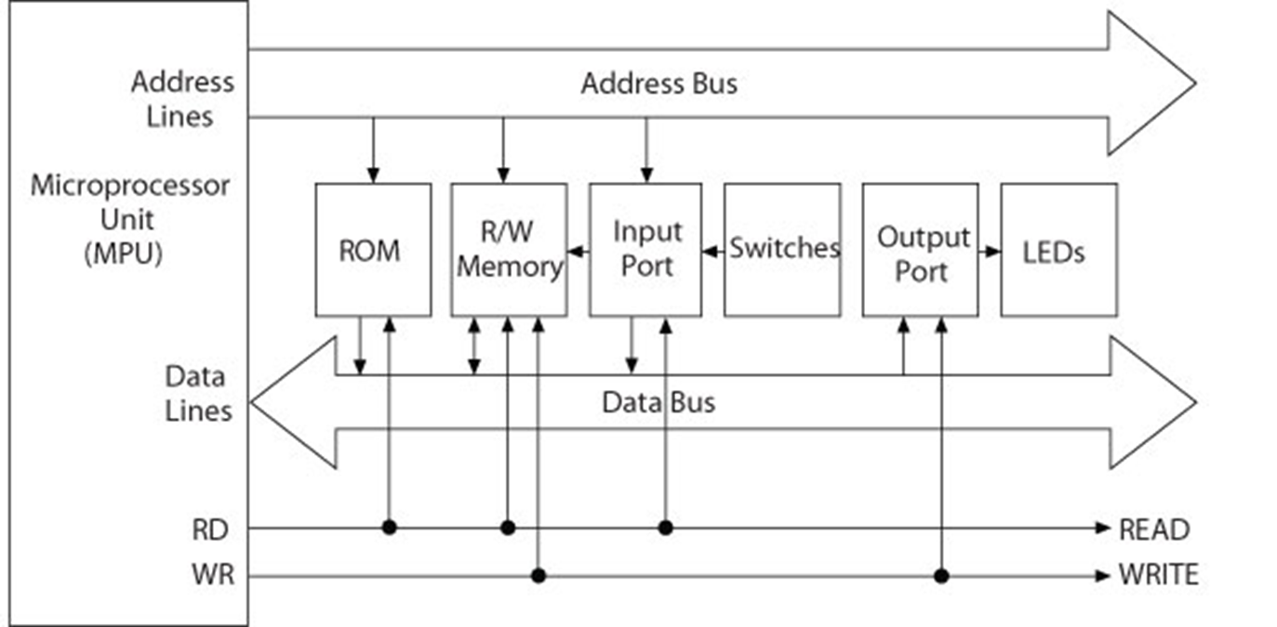
Microprocessor Based System
Com
Address bus
Unidirectional
Memory and I/O Addresses
Data bus
Bidirectional
Transfers Binary Data and Instructions
Control lines
Read and Write timing signals

Slide 12
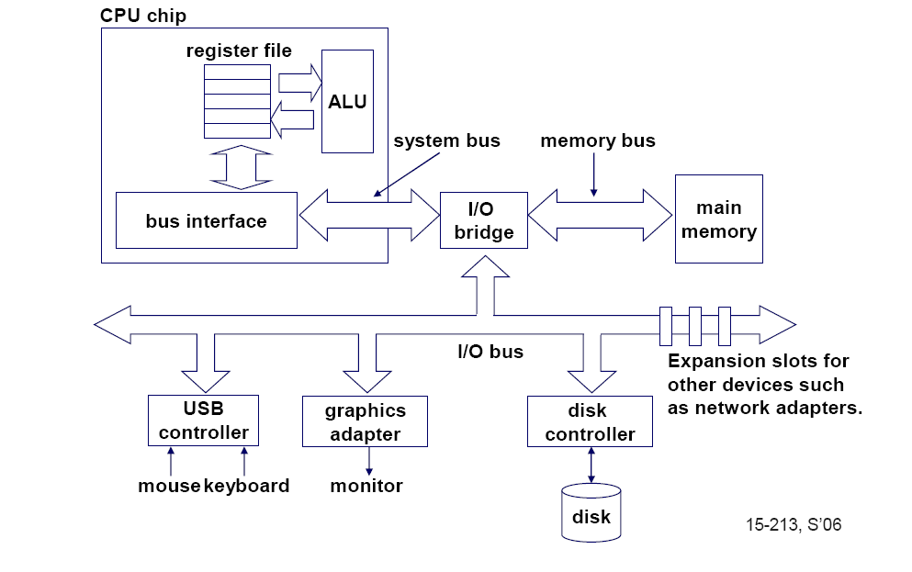
Single-core computer

Slide 13
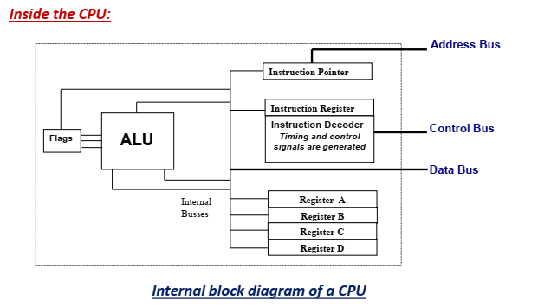
Single-core computer

Slide 14
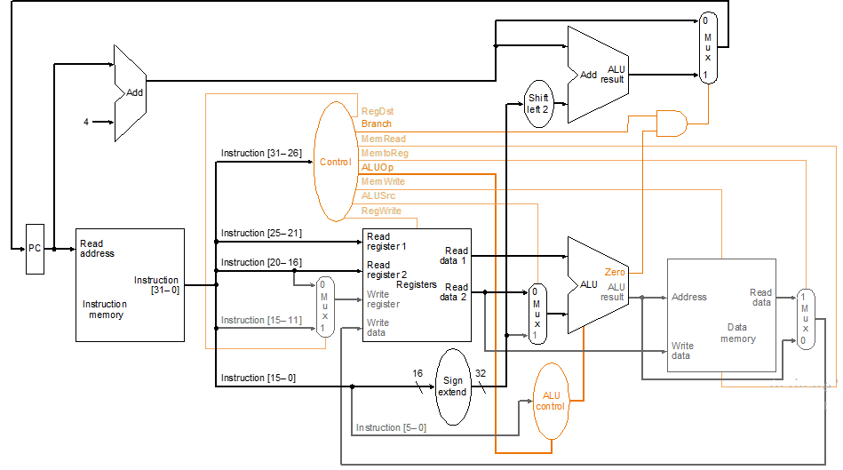
Single Cycle Microprocessor

Slide 15
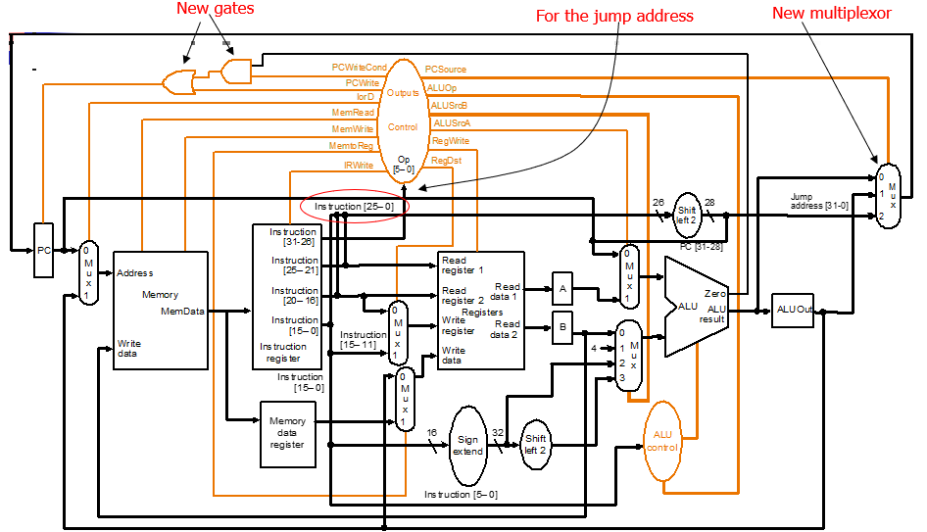
Multi-Cycle Microprocessor

Slide 16
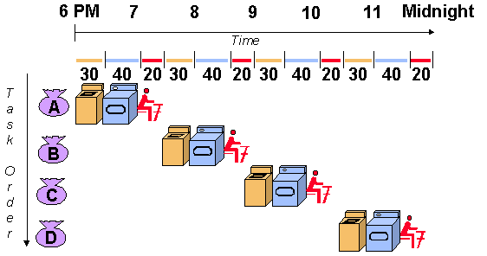
Pipeline Microprocessor

Slide 17
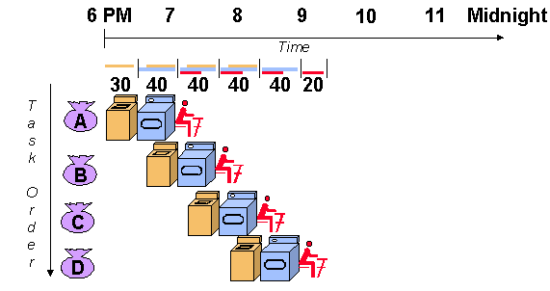
Pipeline Microprocessor

Slide 18
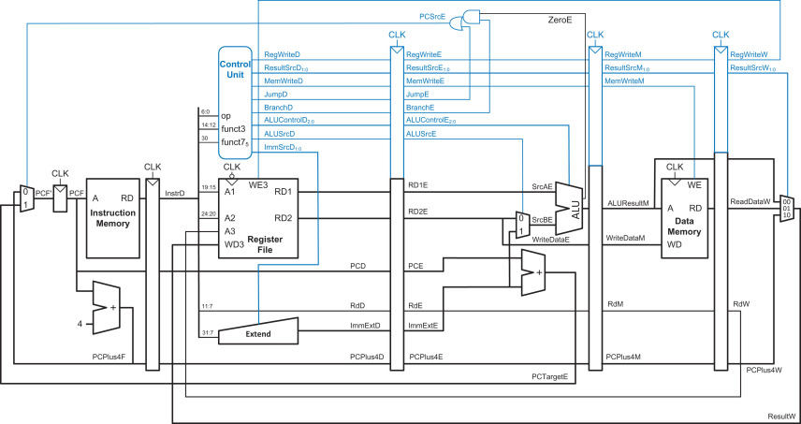
Pipeline Microprocessor

Slide 19
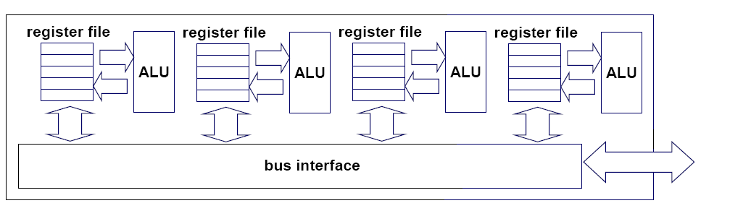
Multi-core architectures
Replicate multiple processor cores on a single die.
Core 1
Core 2
Core 3
Core 4
Multi-core CPU chip

Slide 20
The cores run in parallel
thread 1
thread 2
thread 3
thread 4
core
1
core
2
core
3
core
4

Slide 21
Within each core, threads are time-sliced (just like on a uniprocessor)
several
threads
several
threads
several
threads
several
threads
core
1
core
2
core
3
core
4

Slide 22
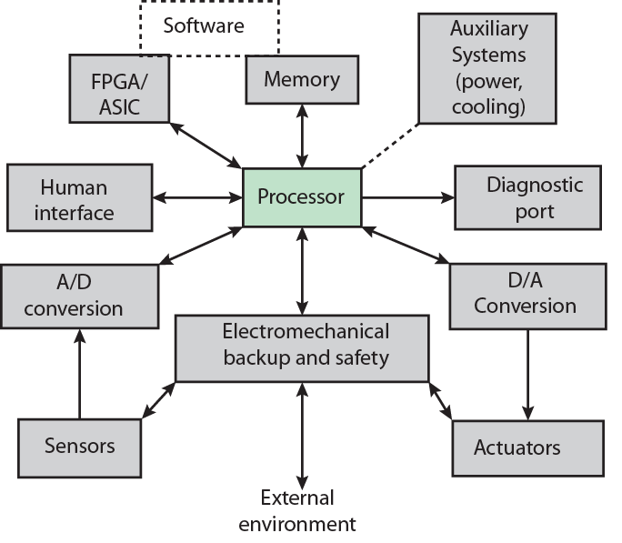
Possible Organization of an Embedded System

Slide 23
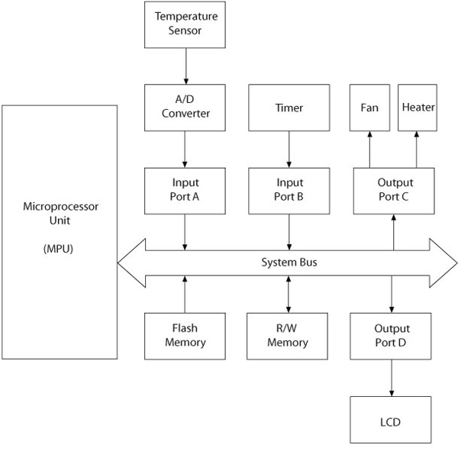
MPU-Based Time and Temperature System
MPU based system includes microprocessor, memory, I/O ports, and support devices (such as timers) on a single semiconductor chip
Buses are generally not available to a system designer
I/O ports are generally multiplexed and can be programmed to perform different functions

Slide 24
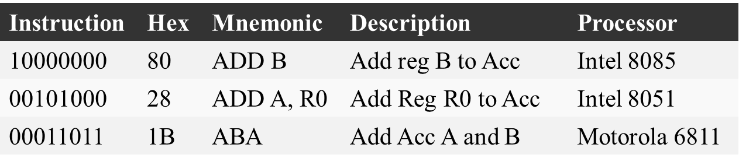
Software
Machine Language (0-1)
  Binary Instructions
  Difficult to decipher and write
    Error-prone
  All programs converted into machine language for execution
Mnemonic Machine Language (Assembly)
  Machine instructions represented in mnemonics
  One-to-one correspondence
  Efficient execution and use of memory
  Machine-specific

Slide 25
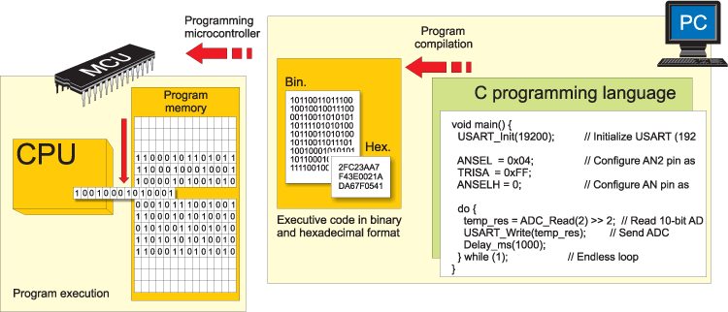
Software
High-Level Languages
  BASIC, C, and C++
  Written in statements of spoken languages
  Machine independent
  Easy to write and troubleshoot
  Larger memory and less efficient execution

Slide 26
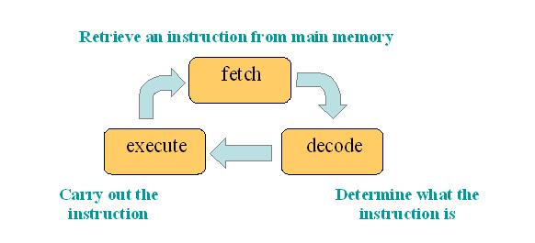
Operation of CPU
• Fetch cycle (phase):
o The CPU puts the address of the instruction to be executed on the address bus. The address information comes from the program counter (PC) maintained by the control unit.
o The control bus holds the information for reading the memory location and the data bus holds the instruction from the memory which is stored into the instruction register (IR)
o PC is updated to point to the next instruction.
• Execute cycle (phase):
o Instruction in the IR is decoded
o The required data transfer and the required logical and arithmetic operation are
performed
o The result is written back either to one of the registers or memory or I/O device

